Slide 2
Optimization of UrbanServices Using Priority Queue
Submitted to:
Department of Information Technology

Slide 3
Supervised by: Dr.Prashant Lakkadwala
Team Members
1.Jahnavi Mandloi
2. Jayshree Dave
3. Mahee Dubey
4.Minakshi Soni

Slide 4
Project Presentation Outline
Abstract
Introduction
Problem Statement
Survey of Existing Systems
Project Objectives
Requirement Analysis
Solution Proposed
The Outcome Discussion
Conclusion and limitations

Slide 5
Abstract
UrbanServices is a Java-based smart city initiative aimed at enhancing urban management in areas such as waste management, water resource management, and citizen engagement. The project seeks to address common urban challenges like waste disposal inefficiencies, water scarcity, and limited community interaction by leveraging modern technologies. By developing a streamlined platform, UrbanServices enables residents to report issues, optimize waste collection based on waste type priorities, monitor water usage in real-time, and foster community collaboration. The system promotes sustainability, operational efficiency, and a higher quality of life for urban dwellers through its comprehensive, real-time data-driven approach.

Slide 6
Introduction
UrbanServices is a smart city project aimed at streamlining and enhancing urban management through advanced technologies. The focus of the project is on Waste Management, Water Management, and Citizen Engagement. The project leverages Java-based technologies to offer a comprehensive solution for efficient urban resource management while promoting sustainability and enhancing community involvement.
In modern urban spaces, managing resources such as waste collection, water distribution, and citizen grievances efficiently has become a significant challenge. UrbanServices addresses these issues by optimizing operations and promoting engagement among citizens to improve overall city management.

Slide 7
The Problem Statement
As urbanization continues to expand, cities face numerous challenges in managing essential services such as waste collection, water distribution, and citizen engagement. The inefficiency in handling these resources leads to increased operational costs, environmental damage, and diminished quality of life for residents.
The problem involves:
Waste Management: Inefficient collection and processing of various types of waste, leading to improper disposal, environmental hazards, and higher operational costs.
Water Management: Lack of real-time monitoring, leak detection, and optimized distribution, resulting in water wastage and unregulated consumption.
Citizen Engagement: Insufficient channels for residents to report issues or participate in city governance, causing delays in addressing problems and reduced public trust.

Slide 8
Survey of Existing Systems
Waste Management
Traditional waste management systems follow regular collection schedules and rely on manual reporting for issues leading to delays in addressing urgent waste. These systems lack a priority mechanism, treating all waste types equally, which can leave hazardous or electronic waste unattended until scheduled collections. A proposed solution is a priority-based waste management system, where waste is categorized by urgency and environmental risk. High-risk waste, like hazardous materials, receives priority for quicker disposal, ensuring more efficient and safer waste management.
Water Management
Most cities lack real-time monitoring of water usage, resulting in undetected leaks that waste water. Without proper monitoring, it is challenging to ensure quality and conservation of water.
Citizen Engagement
In many urban areas, citizens find it difficult to communicate with city authorities to report issues such as damaged infrastructure, unsafe conditions, or service outages. Existing systems often involve manual reporting, which leads to delays in resolving issues.

Slide 9
Objectives
To develop a smart city solution, UrbanServices, that leverages technology to improve waste management, water management, and citizen engagement.
The system will prioritize different types of waste, monitor water resources in real-time, and provide a platform for citizens to interact with city services effectively.

Slide 10
Hardware and Software Requiirement
Software
Operating System | Windows
Frontend Technologies | HTML, CSS for designing the user interfaces
Database | MYSQL
Programming Languages | Java
Integrated Development Environment (IDE): | Netbeans
Hardware
RAM | 1GB
Processor | Minimum Dual Core Series

Slide 11
Functional requirement
User Registration and Login:
The system must allow users (admin and citizens) to register and log in using unique credentials.
Registration form validation must ensure correct input formats (email, contact number, password strength).
Waste Management Module:
Users can report different types of waste (e.g., organic, hazardous, recyclable).
The system assigns a priority based on the type of waste (e.g., hazardous = high priority).
A queue-based task management system resolves waste issues based on priority.
Water Management Module:
Users can report water issues or track water usage.
The system allows for monitoring water resources in real-time.
Citizen Engagement:
Users can submit feedback or report general issues related to the city's operations.
The system should allow for two-way communication between users and city officials.
Dashboard for Admin:
Admin can view waste, water, and citizen reports.
Admin can prioritize and resolve issues based on the severity or urgency.

Slide 12
Non functional requirement
Performance:
The system must respond to user actions (such as submitting a form) within 3 seconds.
Security:
User data, including passwords, must be encrypted.
Usability:
The user interface must be intuitive, with easy navigation across different modules.
The system should provide real-time feedback and validation when users enter incorrect information (e.g., invalid email format).
Reliability:
The system should have an uptime of 99.9% and must reliably store user data in the database.
Scalability:
The system must be designed to accommodate future expansion, such as additional waste types or more city services.
Maintainability:
The system code should be modular, allowing for easy updates and maintenance.

Slide 13
Solution Proposed
UrbanServices proposes a smart city platform using Java that integrates waste management, water management, and citizen engagement into a unified system. The waste management component categorizes waste (organic, hazardous, recyclable, electronic) and assigns priority levels (high, medium, low), ensuring higher-priority issues are addressed first through a task management system.
A real-time dashboard tracks the progress of waste-related activities. The water management system monitors water usage, detects leaks to optimize public space watering.
Additionally, the citizen engagement platform allows residents to report issues, provide feedback, and access city service information, enabling city officials to respond promptly and manage problem resolution effectively.

Slide 14
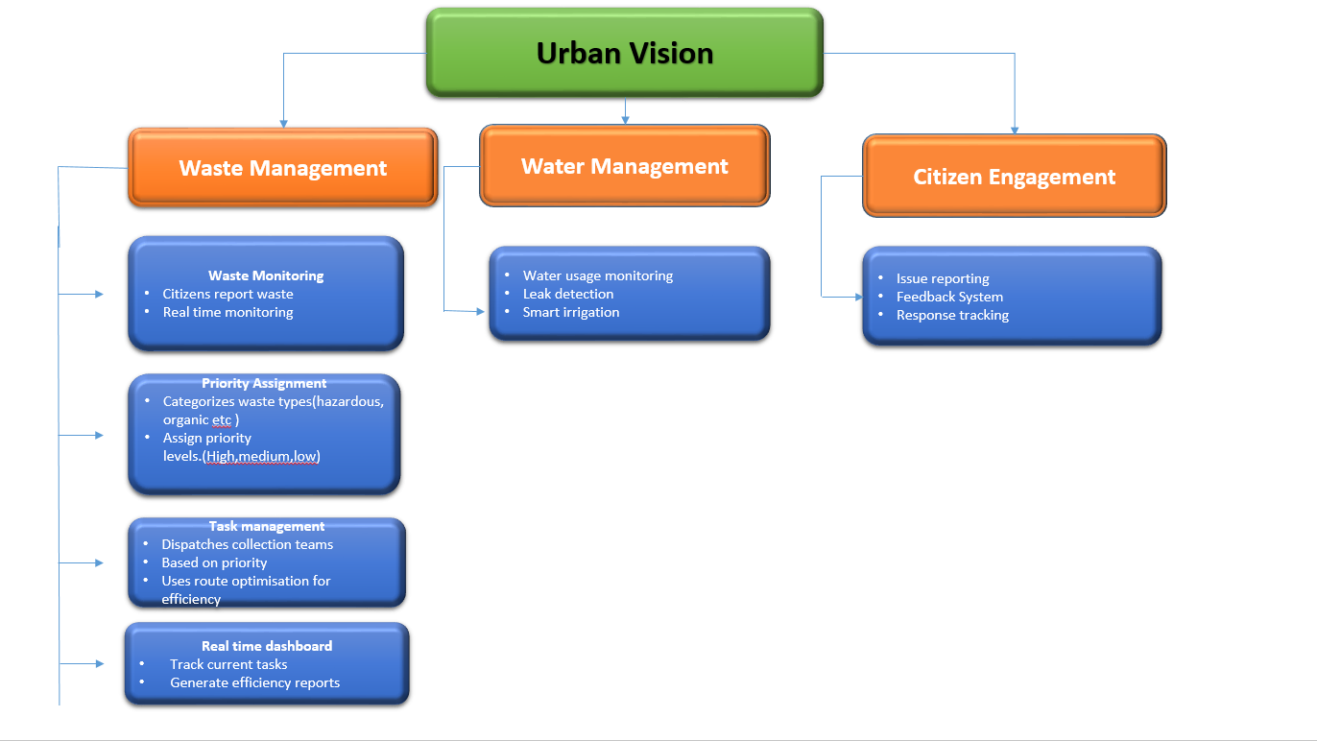
Block Diagram

Slide 15
The Outcome Discussion
Improved Urban Services: The project aims to streamline and optimize the management of essential city services, making them more efficient and responsive to citizen needs.
Enhanced Citizen Engagement: Citizens will have a voice in urban governance, with the ability to report issues and get timely resolutions.
Better Resource Allocation: Administrators will be able to allocate resources effectively, thanks to the prioritization system and real-time monitoring capabilities.

Slide 16
Conclusion and Limitation
Conclusion
The UrbanServices Smart City Project offers a comprehensive solution to managing key urban challenges like waste management, water management, and citizen engagement. By prioritizing waste types, streamlining resource allocation, and ensuring an active feedback loop between citizens and administrators, the project improves city operations' efficiency and sustainability.
Limitations
Scalability Concerns: While the system is designed to scale, in practice, managing a significantly large city with millions of users and reports may require more robust infrastructure and database management to maintain performance.
Dependency on User Reports: The system heavily relies on user-generated reports for waste and water issues. Without active user participation, critical issues might go unreported.
Internet Dependency: As a web-based solution, the system's functionality depends on a stable internet connection. In areas with poor connectivity, this could limit access for users.

Slide 17
Q&A

Slide 18
THANKS

